Slide 1

Cookbooks Overview
Write your Name
Cookbooks serve as essential resources that compile diverse culinary knowledge and practices. They provide structured recipes and crucial cooking techniques, enabling both novices and experienced chefs to elevate their culinary skills. This overview highlights the significance and various components integral to effective cookbooks.

Slide 2
Introduction
A cookbook is a collection of recipes and cooking instructions designed to help users prepare meals efficiently. This presentation explores the main aspects of cookbooks, their history, and key components.

Slide 3
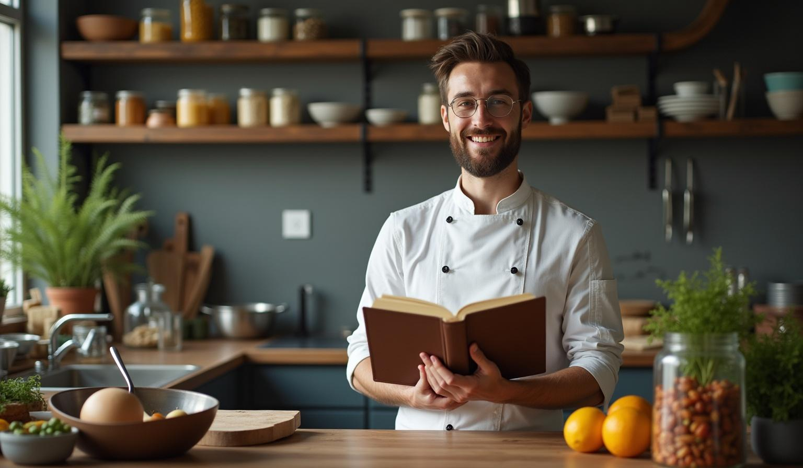
Introduction to Cookbooks
01

Slide 4
Definition and Purpose
A cookbook is a written resource that compiles recipes and cooking methods. Its primary purpose is to guide users in creating various dishes with clear, structured instructions.

Slide 5
History and Evolution
Cookbooks have evolved from ancient handwritten manuscripts to modern printed and digital formats, reflecting changes in culinary trends and technology. They document cultural and historical food practices.

Slide 6
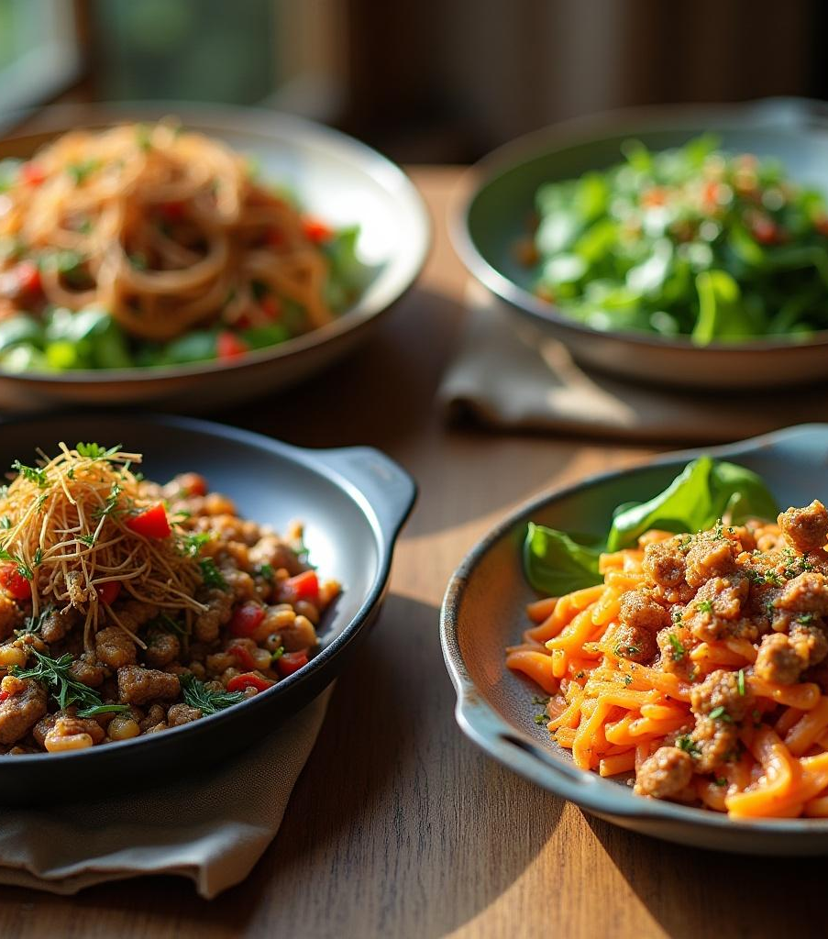
Types of Cookbooks
Cookbooks vary by focus: regional cuisines, dietary needs, professional cooking, and quick meals. Each type serves unique audiences and culinary goals, enhancing usability and appeal.

Slide 7
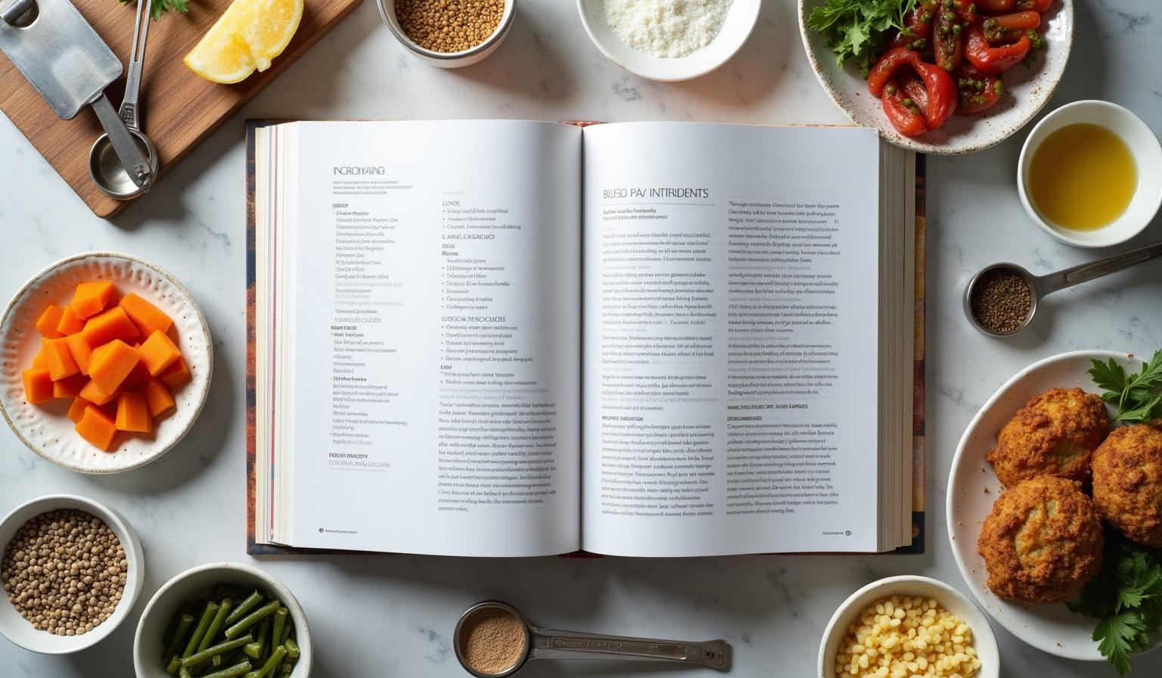
Components of a Cookbook
02

Slide 8
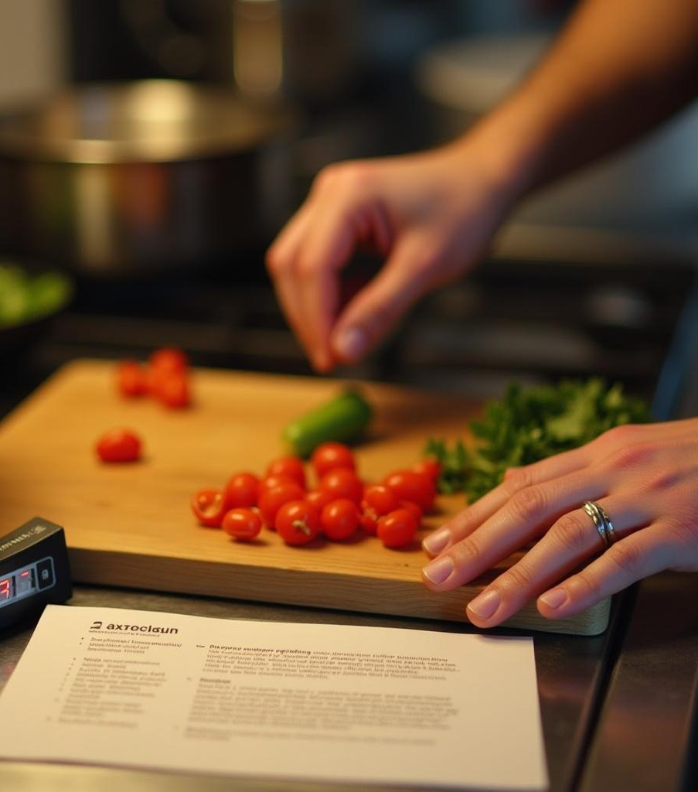
Recipes and Instructions
Recipes detail step-by-step instructions on dish preparation, specifying cooking times, methods, and sequence to ensure consistent and repeatable results.

Slide 9
Ingredients and Measurements
Precise ingredient lists with accurate measurements are essential for recipe success. They help maintain flavor balance and cooking accuracy across various servings.

Slide 10
Cooking Tips and Techniques
Useful tips and methods enhance cooking efficiency and outcomes. They include advice on ingredient selection, cooking tools, and alternative techniques for flexibility.

Slide 11
Conclusions
Cookbooks are vital culinary tools combining historical knowledge and practical details. Their structured content supports diverse cooking needs, inspiring both amateurs and professionals.

Slide 12
Thank you!
www.yourwebsite.com
Do you have any questions?
+00 000 000 000

Slide 13
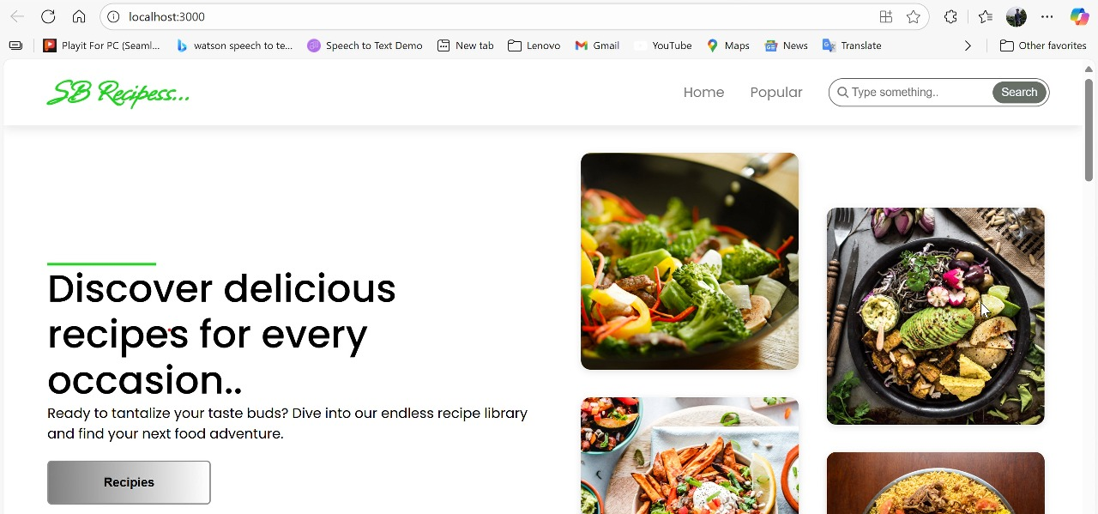

Slide 14
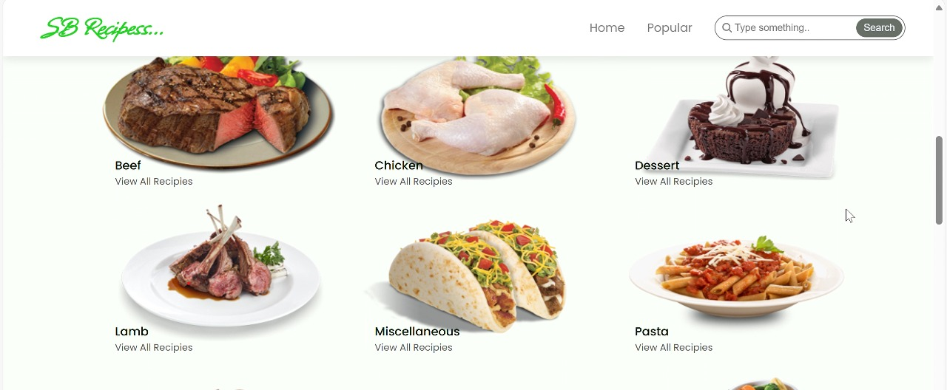

Slide 15
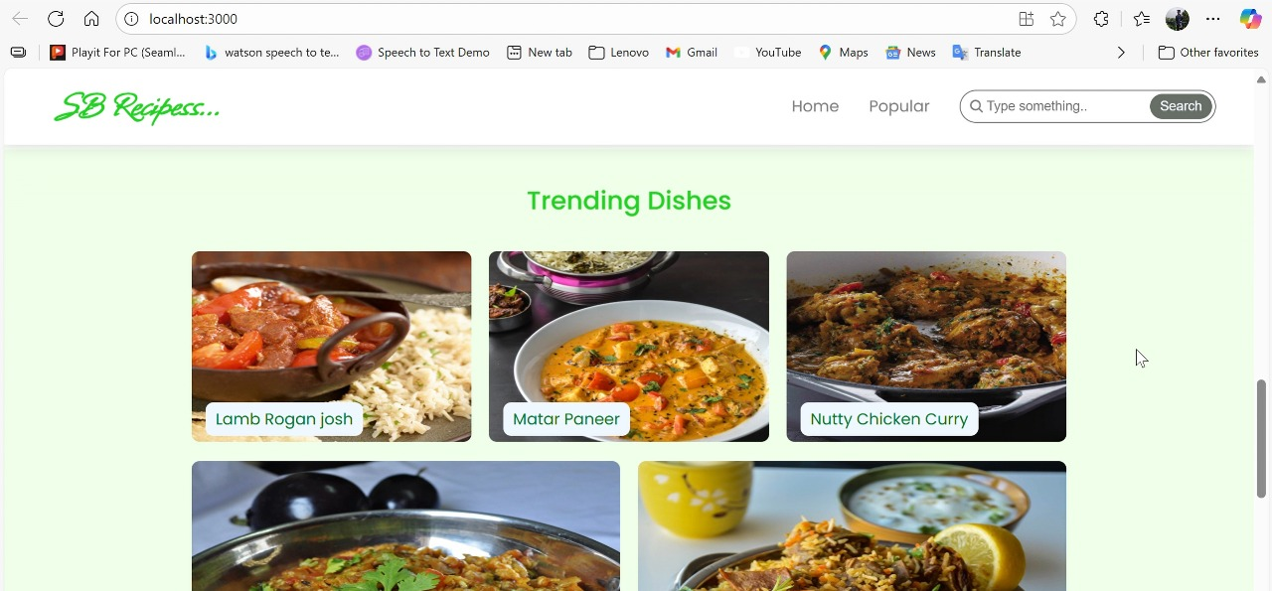

Slide 16
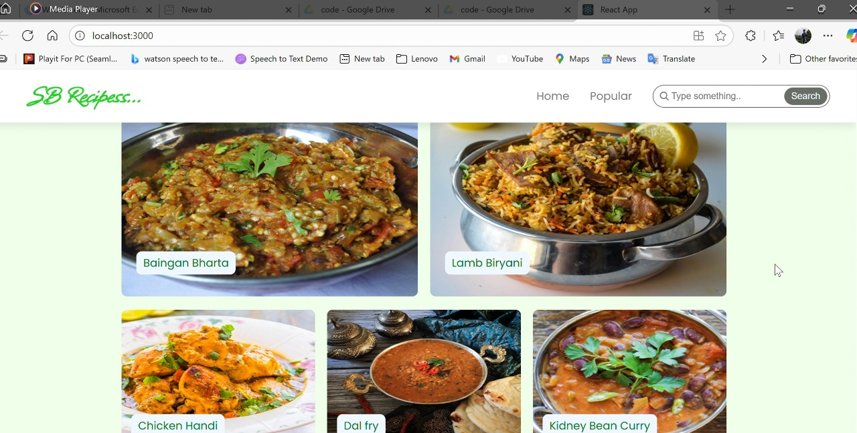

Slide 17
